Slide 1
CONNECTING SPACE TO WEST AFRICAN CROP LAND :
Pilot project for advancing crop monitoring
Dr. Adama SARR
Centre de Suivi Ecologique / University Gaston Berger

Slide 2
Introduction/Background
CILSS and West African countries, faced with a sharp deterioration of the potential production of their agro-sylvo-pastoral systems
An early warning system to monitor and evaluate agro-sylvo-pastoral campaigns to prevent and manage food and nutrition crises in the Sub-region
Remote sensing and advanced scripting techniques provide an opportunity to fill the gaps in crop type, crop area, crop condition, and yield assessment for better decisions
A service to contibute improving the CILSS early warning system (Cadre Harmonisé)

Slide 3
BIG CHALLENGE!
1. Making Science & Data for the benefit of End User needs by focusing on development issues.
2. Connecting Science to the challenges in the local areas to build sustainably the BRIDGE.

Slide 4
OPPORTUNITY FALLING FROM THE SKY
A partnership of USAID, NASA and leading technical organizations, SERVIR WA consortium lead by ICRISAT develops innovative solutions to improve livelihoods and foster self-reliance.
CSE, with 30 years of experience connecting space to ponds, forage and crop areas in Senegal, as member of SERVIR WA helps West African countries using EO data to address critical challenges in food security, water resources, land use land cover, and natural disasters.

Slide 5
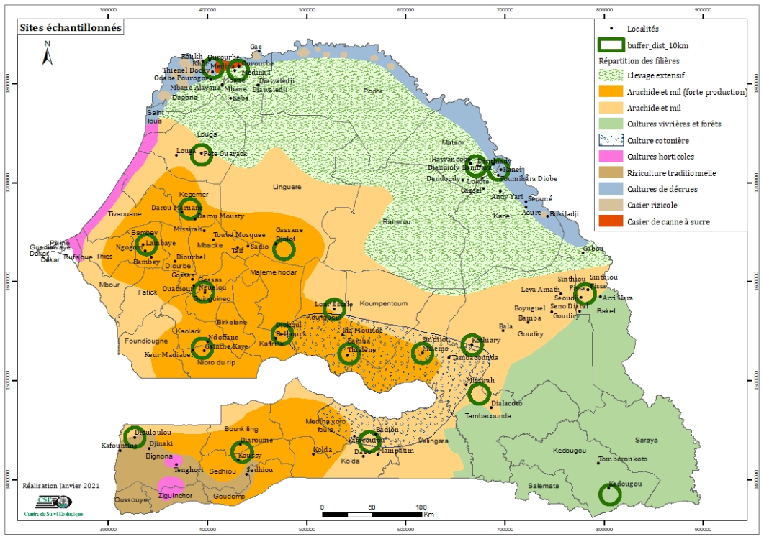
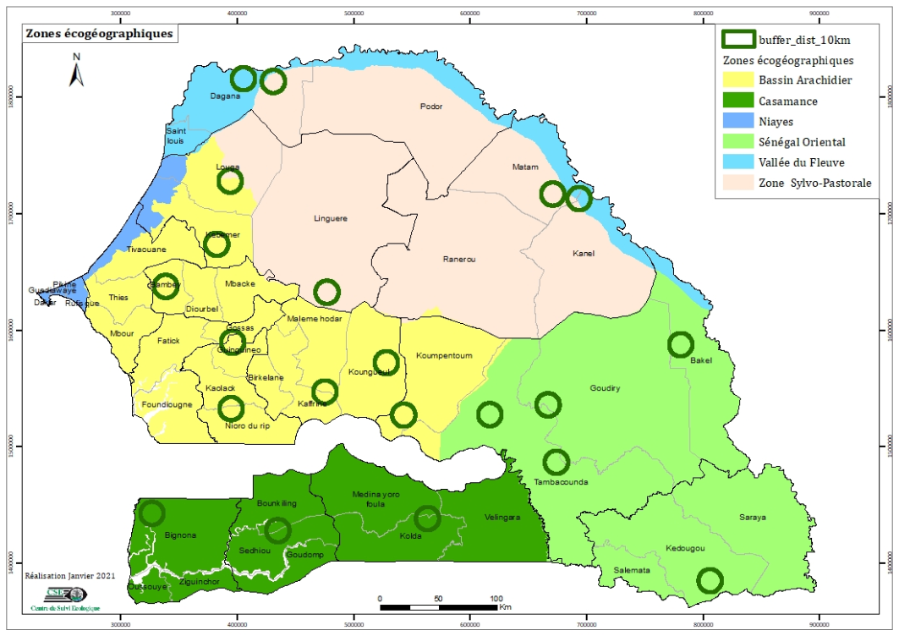
GEOGRAPHICAL COVERAGE
Senegal : Sampling sites accross the Ecological regions

Slide 6
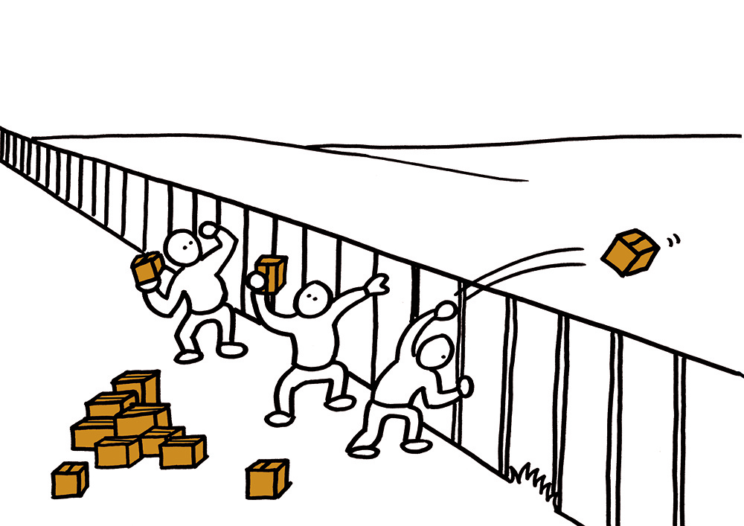
THE OVER THE FENCE METHOD
Experts - Scientists
End-Users

Slide 7
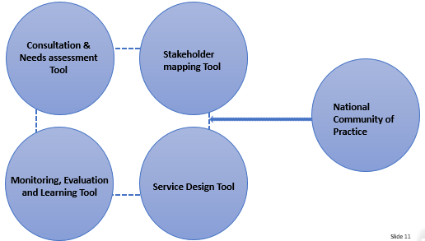
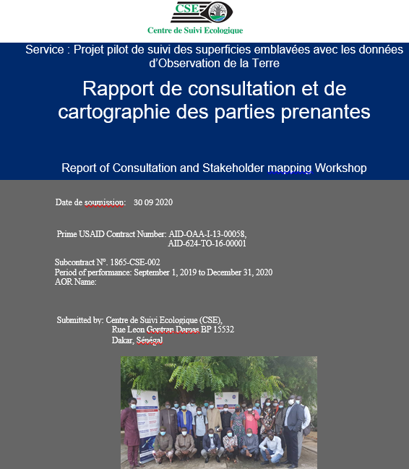
SERVICE PLANNING APPROACH

Slide 8
METHODOLOGICAL APPROACH
Creation of the EO database on pilot sites (Planet, Sentinel 1&2, Landsat)
Design of the dynamic mapping model of the crop areas (2020) by setting up a Deep Learning U-net method
Construction of classical Machine Learning algorithms
Construction of a prediction model for the 2021 acreage
Testing of possible Deep Learning architectures on the areas
Creation of appropriate samples for the Deep Learning models

Slide 9
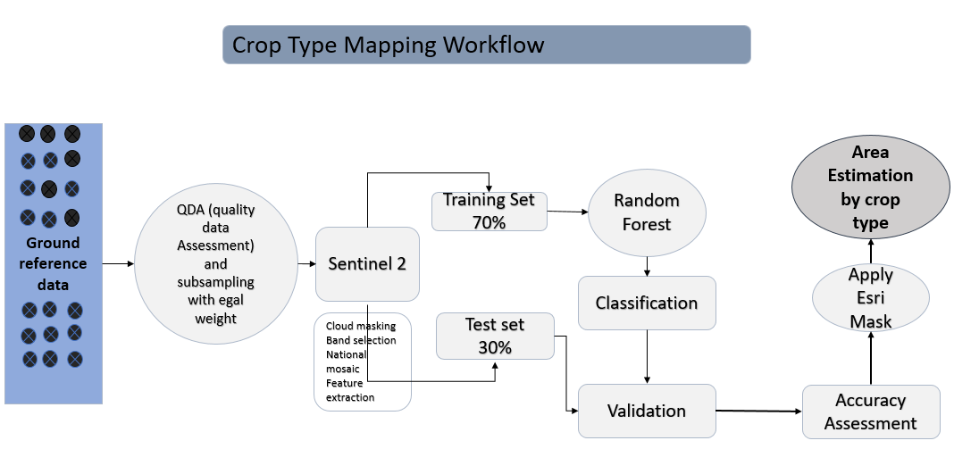
METHODOLOGICAL APPROACH

Slide 10
DATA COLLECTED
Ecogeographic zones

Slide 11
DATA COLLECTED
Main crops :
peanuts
millet (souna and fonio varieties)
sesame
beans
sorghum
corn
cotton
rice
sugar cane
More than 4 000 points GPS
2 445 sample
2948,71 hectares digitized and identified with land use type assignment

Slide 12
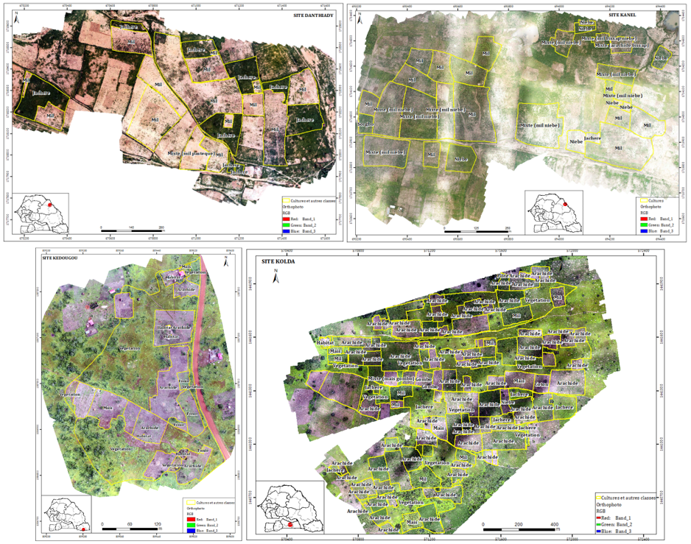
DATA COLLECTED

Slide 13
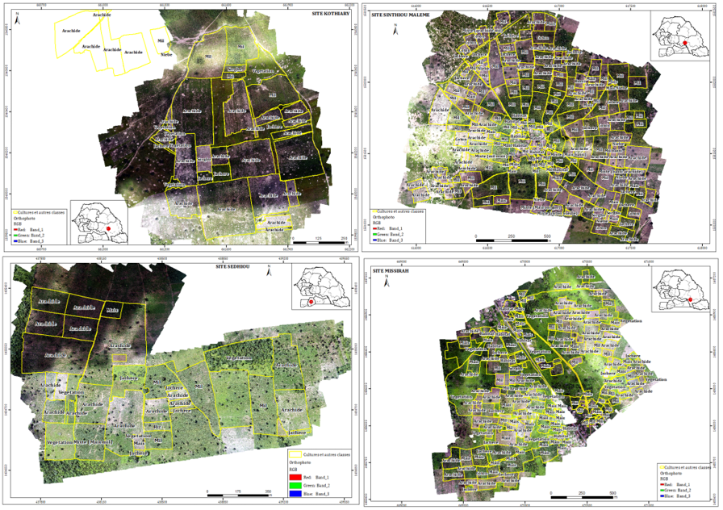
DATA COLLECTED

Slide 14
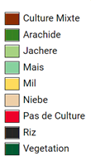
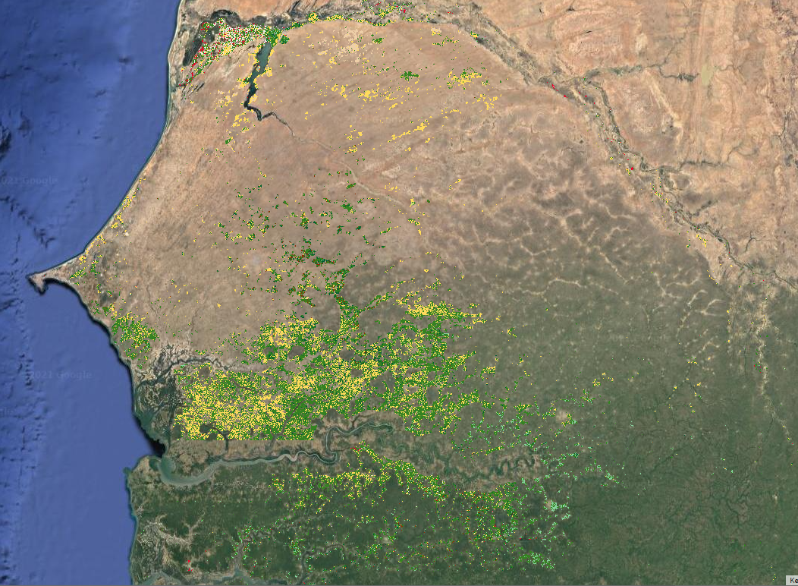
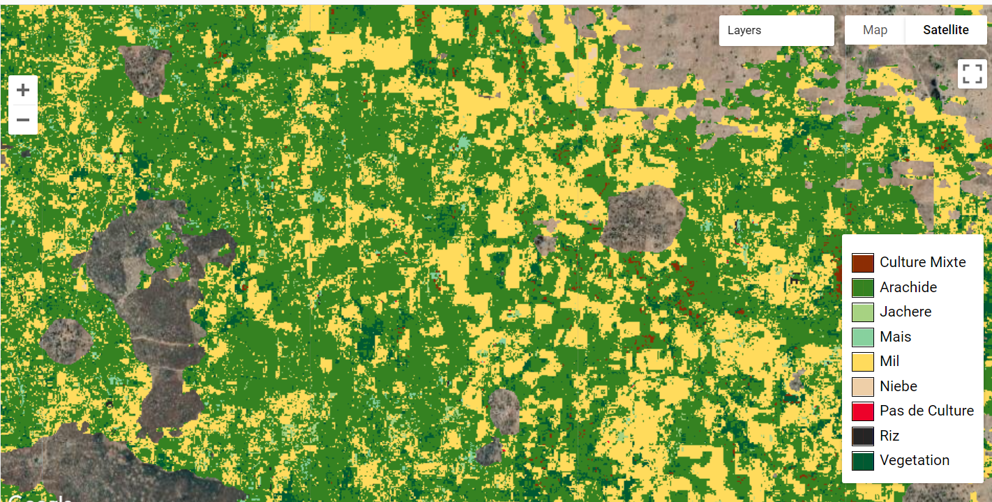
PRELIMINARY RESULTS/OUTPUTS

Slide 15
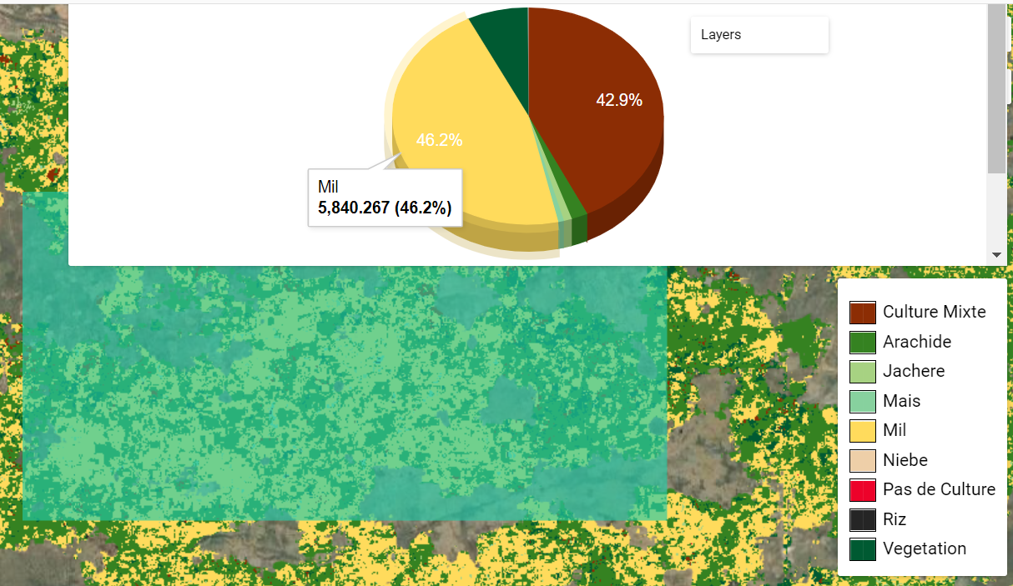
PRELIMINARY RESULTS/OUTPUTS
Overall Accuracy
0.93
Kappa
0.79

Slide 16
NEXT URGENT STEP FOR THE SERVICE
COLLECT FIELD DATA FOR 2022 CROP SEASON
Further improve the model (scripting, calibration, ...)

Slide 17
Conclusion/Expected Outcomes
The crop type mapping is enhanced and scaled up to cover the entire Senegal and then the CILSS region
The CoP takes over the service and insures it sustainability
All materials (tools, models, workflows) are made available

Slide 18
Thank you
Questions?

